Slide 1
noopen

Slide 2
about
This program lets a user to encode any value to an unreadable format and also helps to decode the value. This is done with the help of a key a.k.a OTP(One Time Pad), without key one cannot decode the value.
Each letter of the password is converted to its 8-bit equivalent binary form. The key generated is also an 8-bit binary key.
Thus to encode the password AND, OR & XOR gates are used.

Slide 3
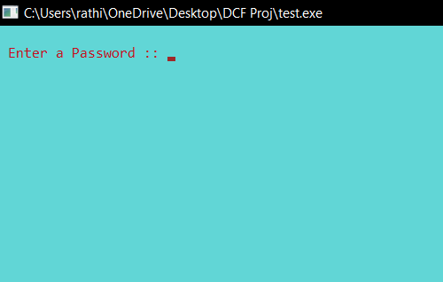
First look

Slide 4
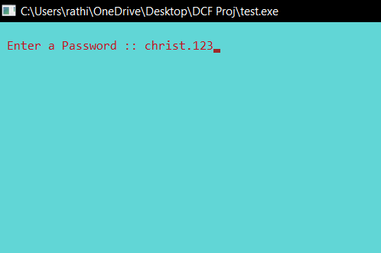
Step 1: Enter a password

Slide 5
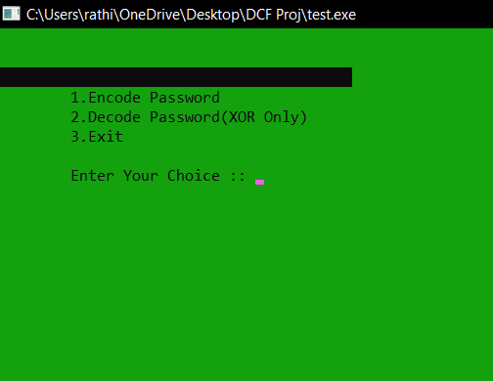
menu

Slide 6
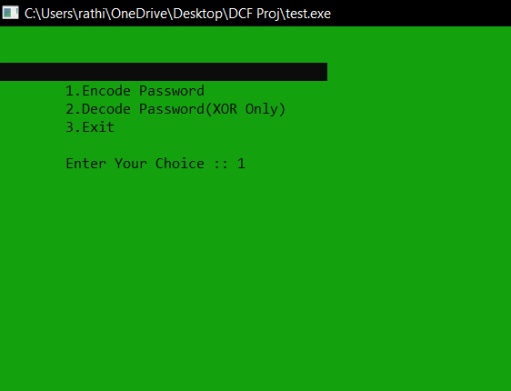
Step 2: select Encode
Step 2: select Encode password

Slide 7
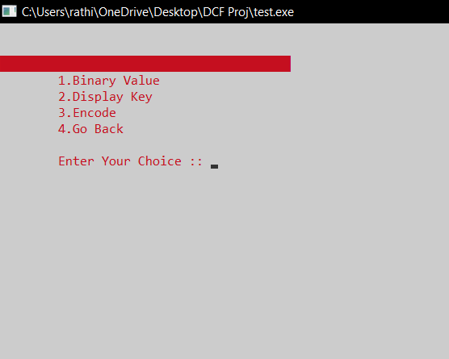
After pressing ‘1’ user will get the following options…

Slide 8
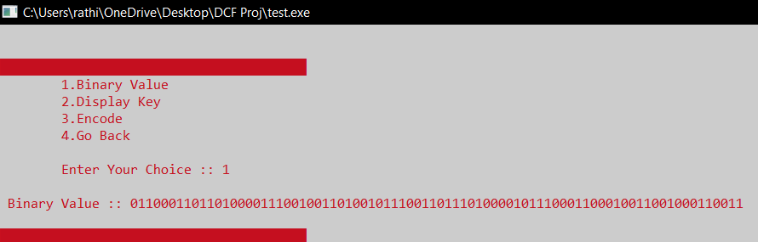
Step 3: Check binary value

Slide 9
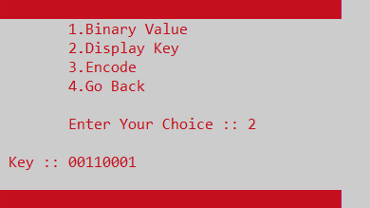
Step 4: check key

Slide 10
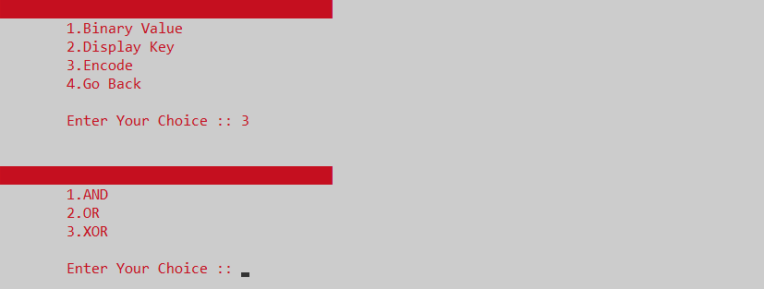
Step 5: select encode

Slide 11
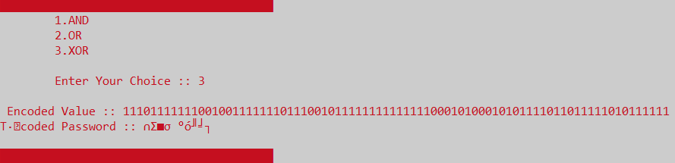
Step 6: encode using xor

Slide 12
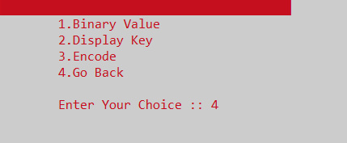
Step 7: go back

Slide 13
Step 7: back to previous menu

Slide 14
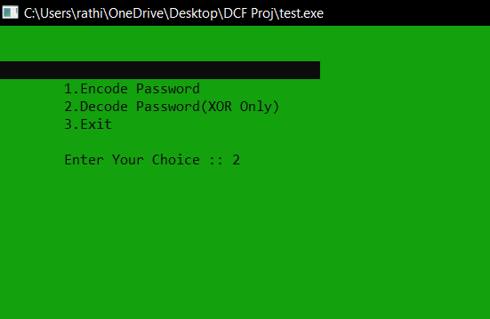
Step 8: Decode password

Slide 15
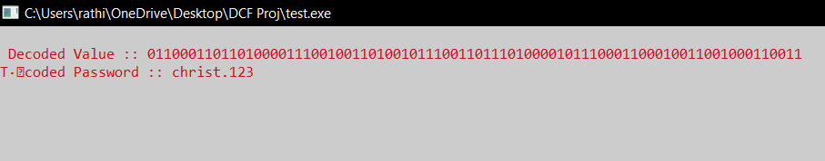
You can see your original password

Slide 16
Application in christ
This program could be used by students and staff of Christ University to help safeguard their private and professional details. This will let the user store their encoded password even if it is public.

Slide 17
Behind the scenes…

Slide 18
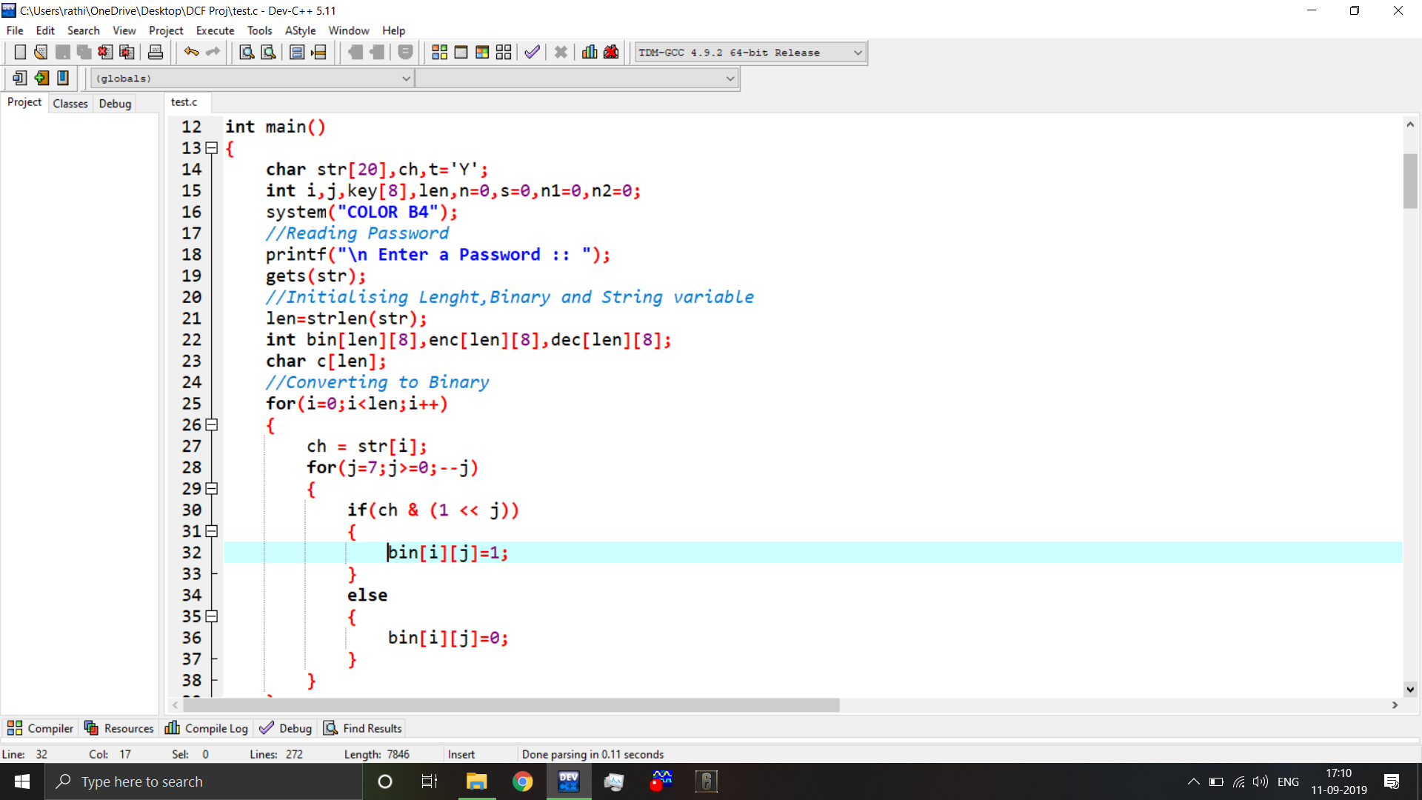

Slide 19
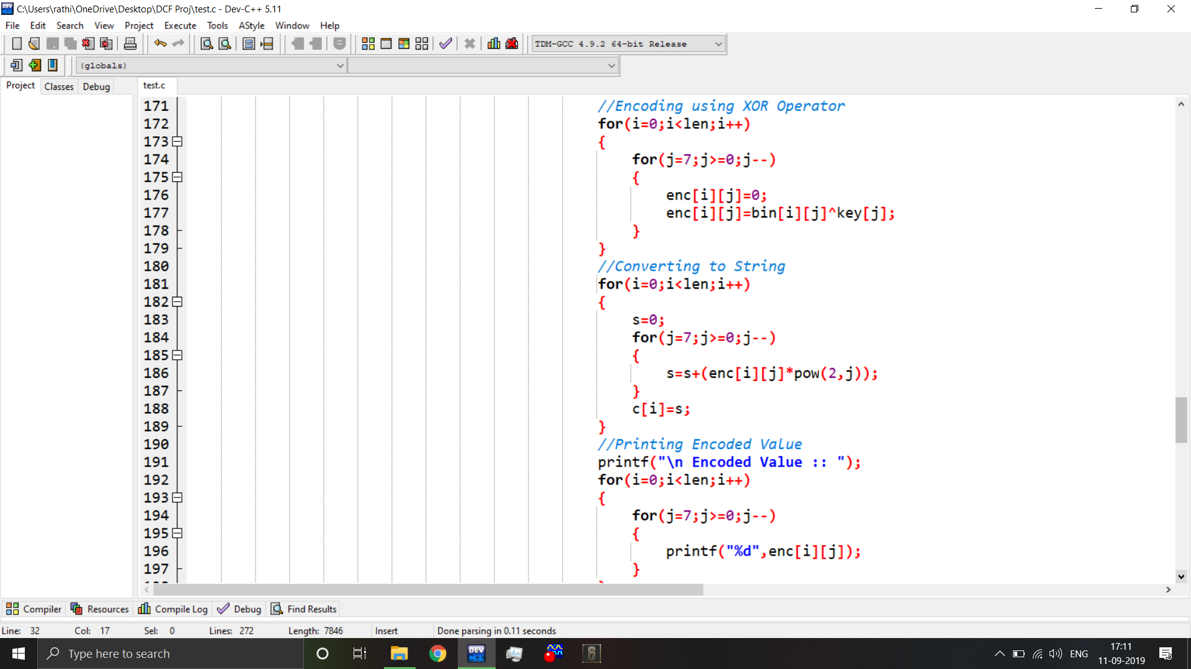

Slide 20
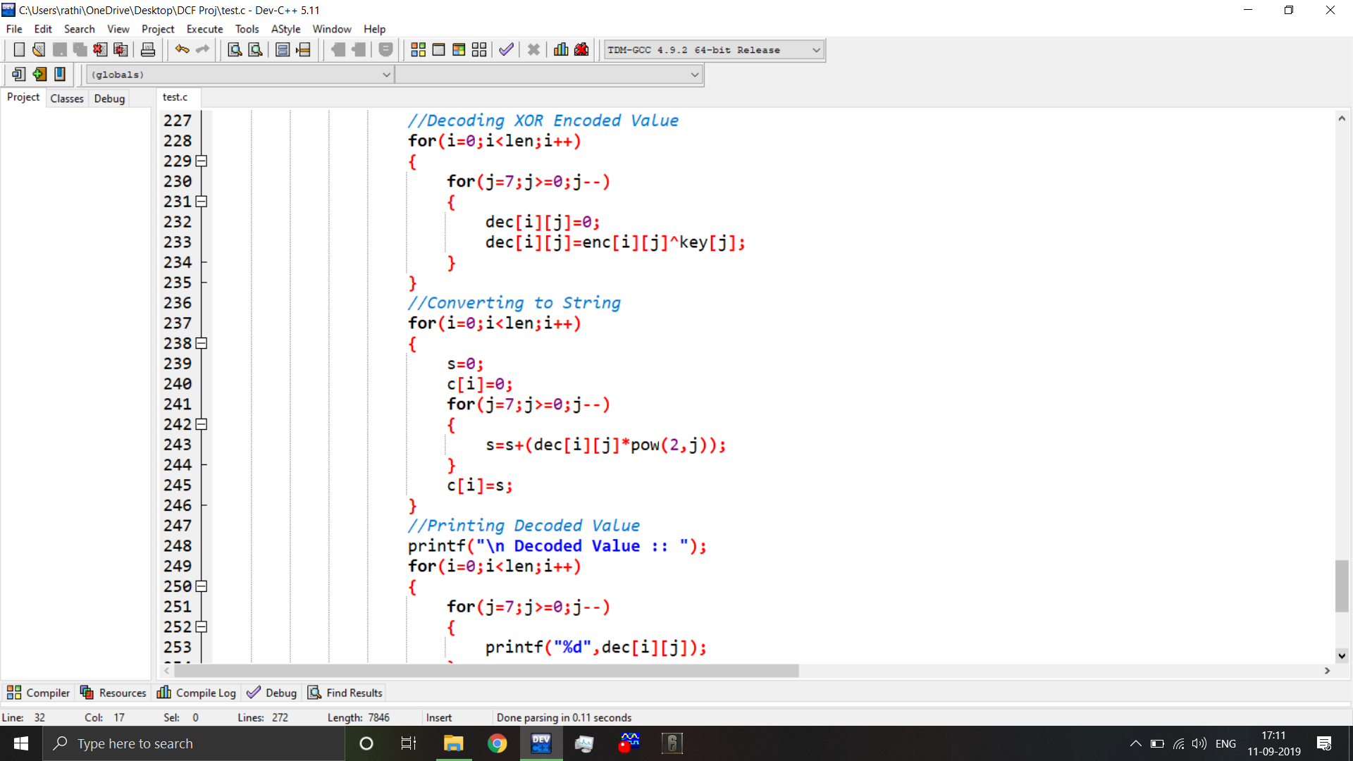

Slide 21
Thank you

